Slide 1

HealthGuard Pro
“Your care is on the way”

Slide 2

About Us
Health Check Pro is dedicated to providing personalized health insights that empower individuals to make informed decisions and improve their well-being. We aim to uplift society by promoting healthier lifestyles and fostering a proactive approach to physical, mental, and nutritional health.
“Take charge of your health today
—one quiz at a time!”

Slide 3
Key Features
01
02
03
04
Provides personalized
health assessments for
users across physical,
mental, and nutritional
aspects.
Enable users to track
and monitor their
overall health status.
Foster team
collaboration and
competition through
a dynamic leaderboard.
Offer real-time feedback
and progress tracking to enhance users' physical
and mental well-being.

Slide 4
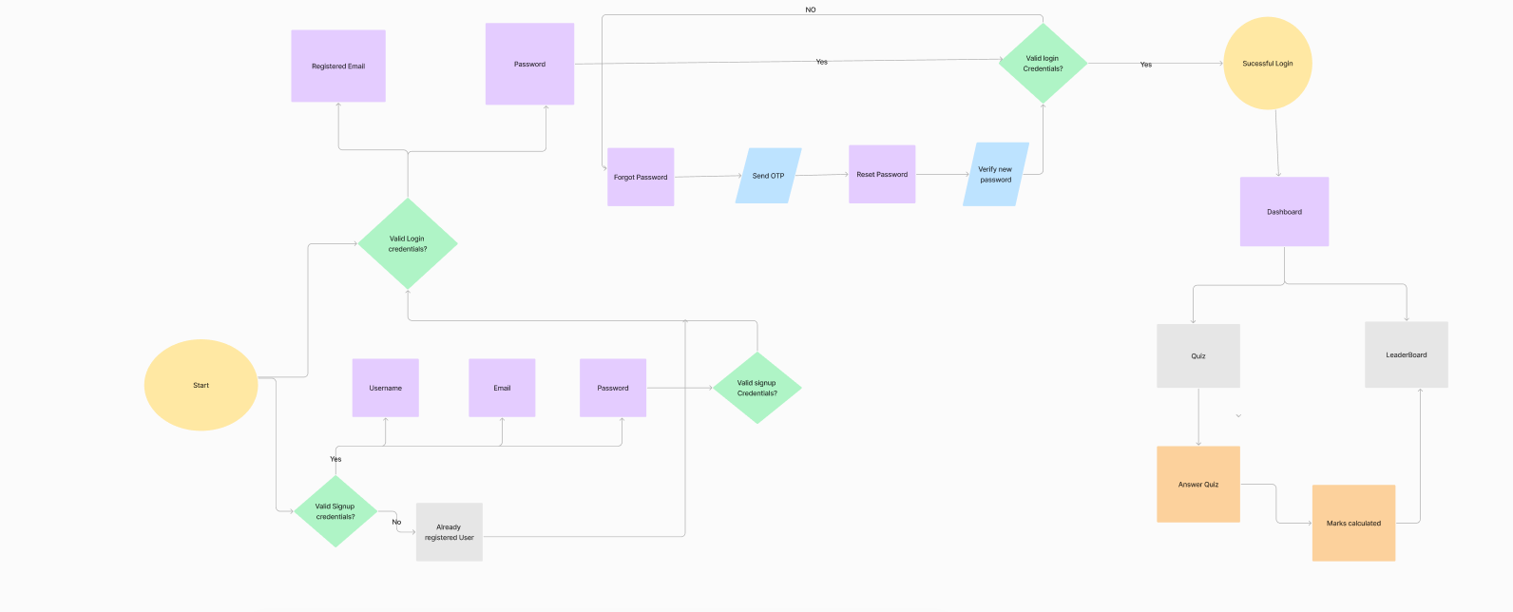
WorkFlow

Slide 5


Registration Page

Slide 6
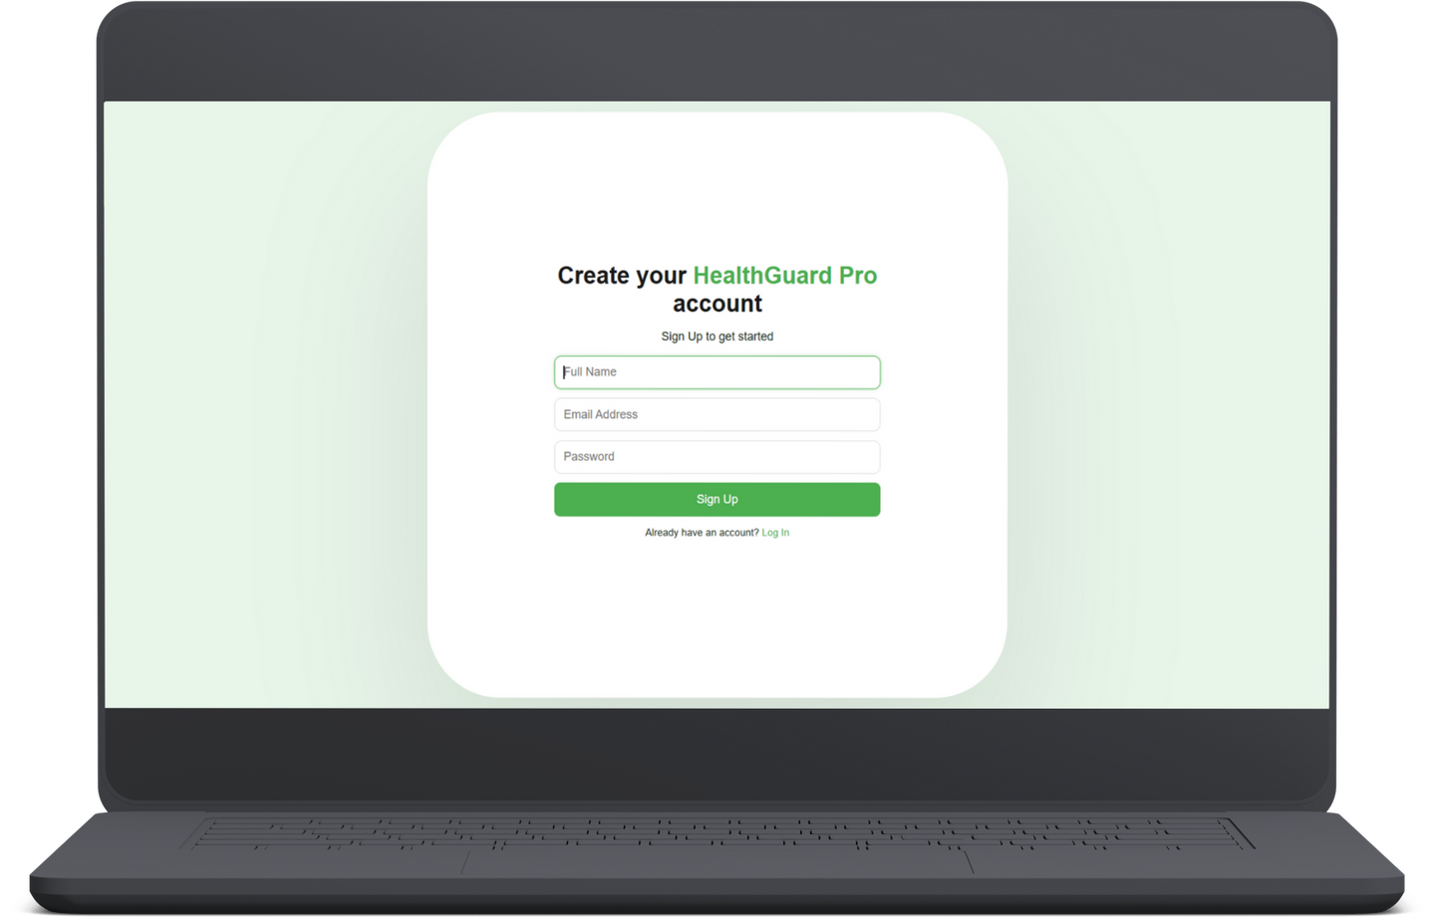
Features
User Registration
Password Strength Indicator
Responsive Design

Slide 7
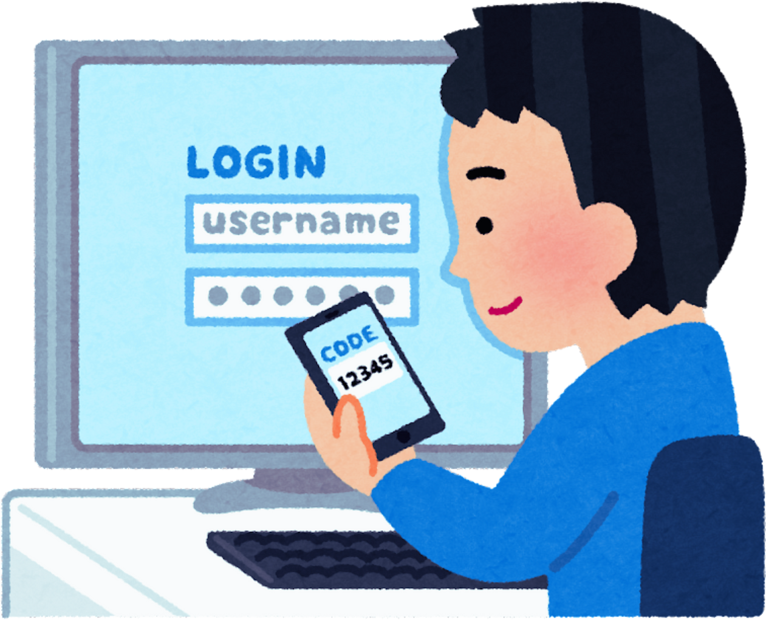
Login Page

Slide 8
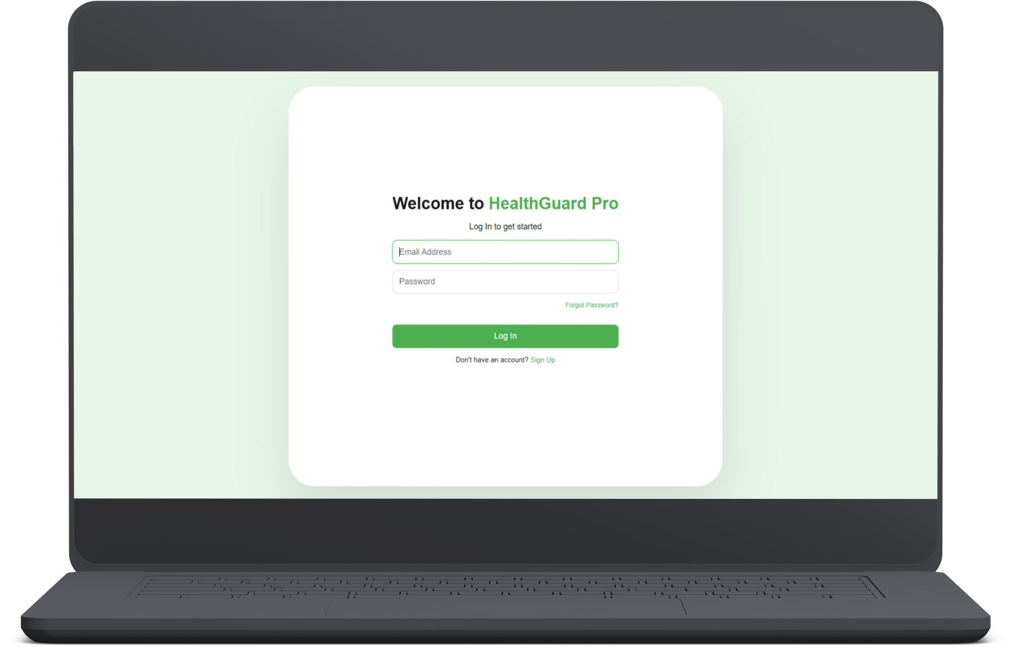
Features
Email and password-based login.
Forgot Password option
User-Friendly Input Fields

Slide 9
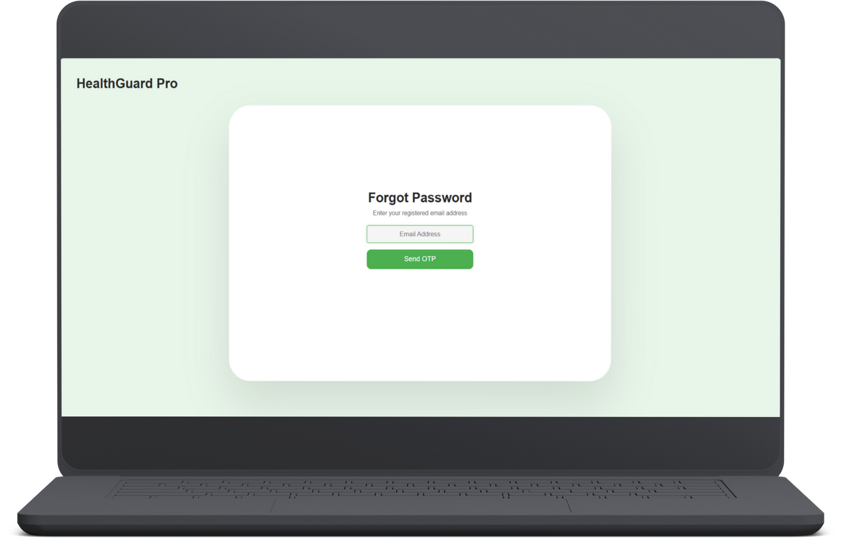
Features
Email Based Password Reset.
Secure User Identification

Slide 10
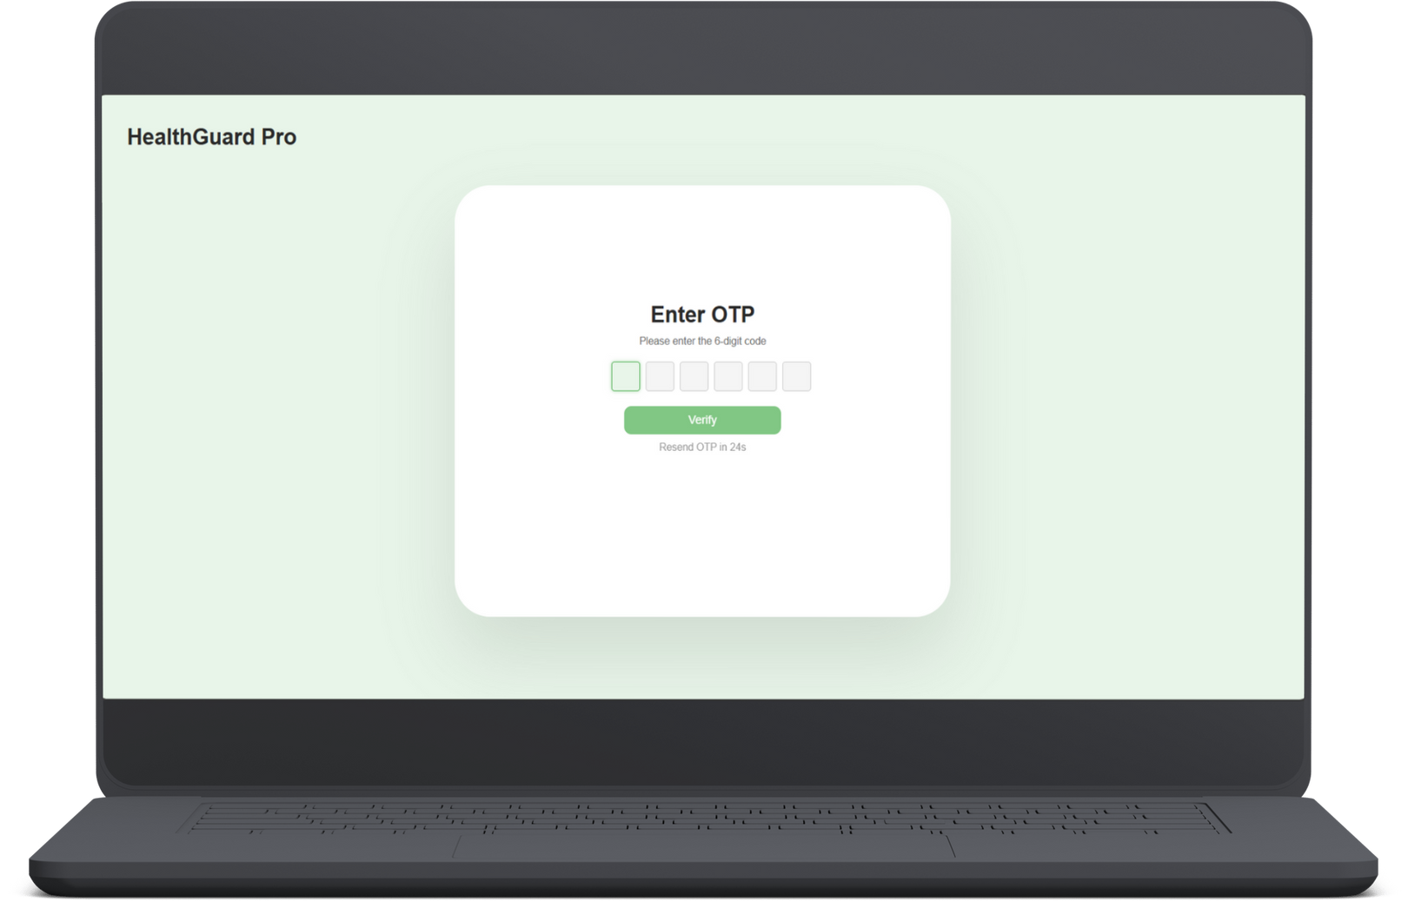
Features
Input Validation
Secure OTP Handling
User Assistance and Retry Mechanisms

Slide 11
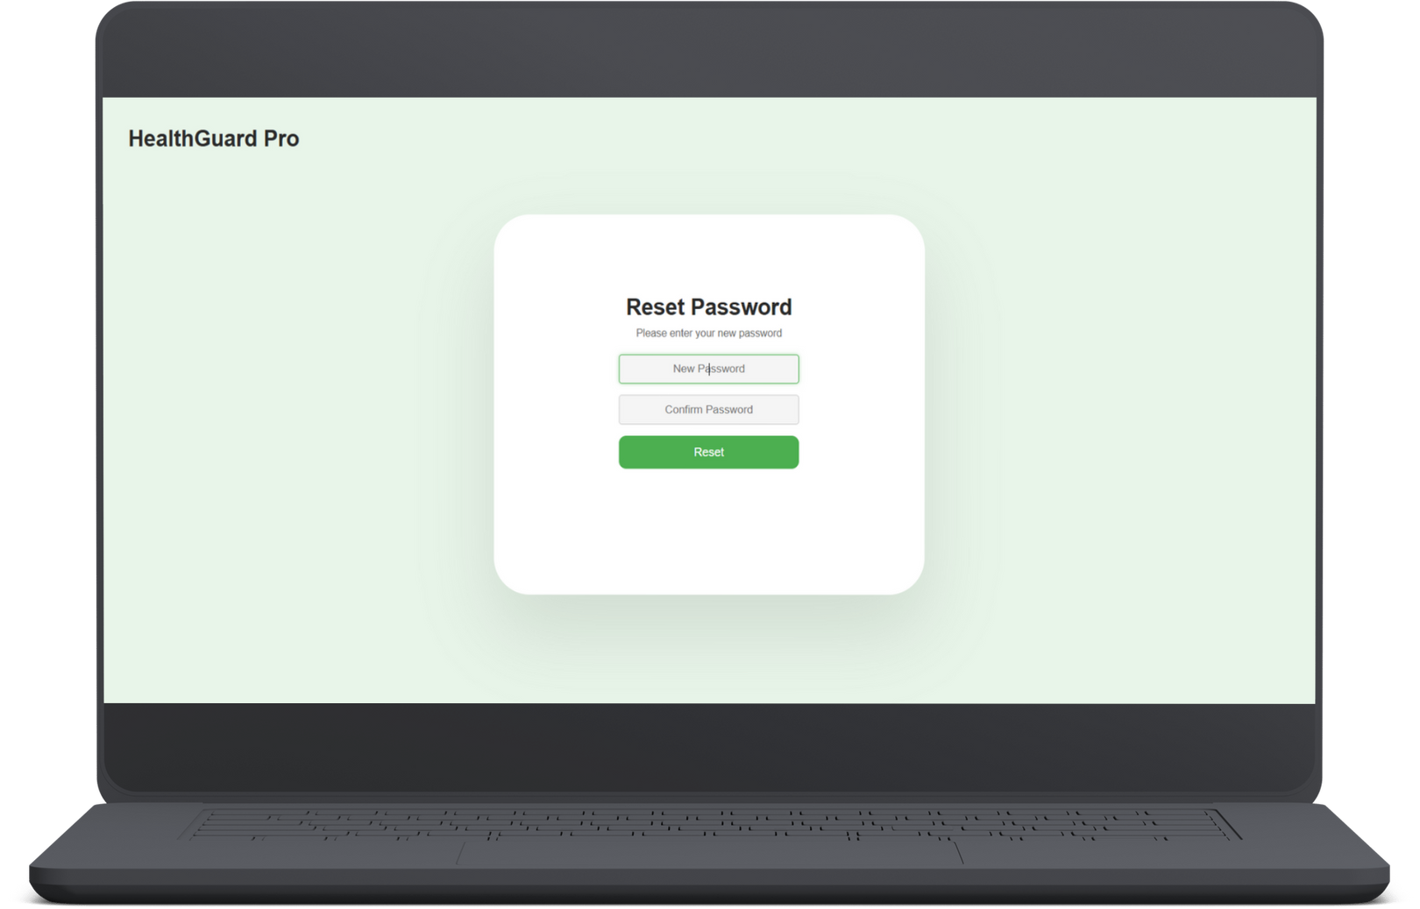
Features
Secure Authentication
Flexible Password Update

Slide 13

Dashboard

Slide 14
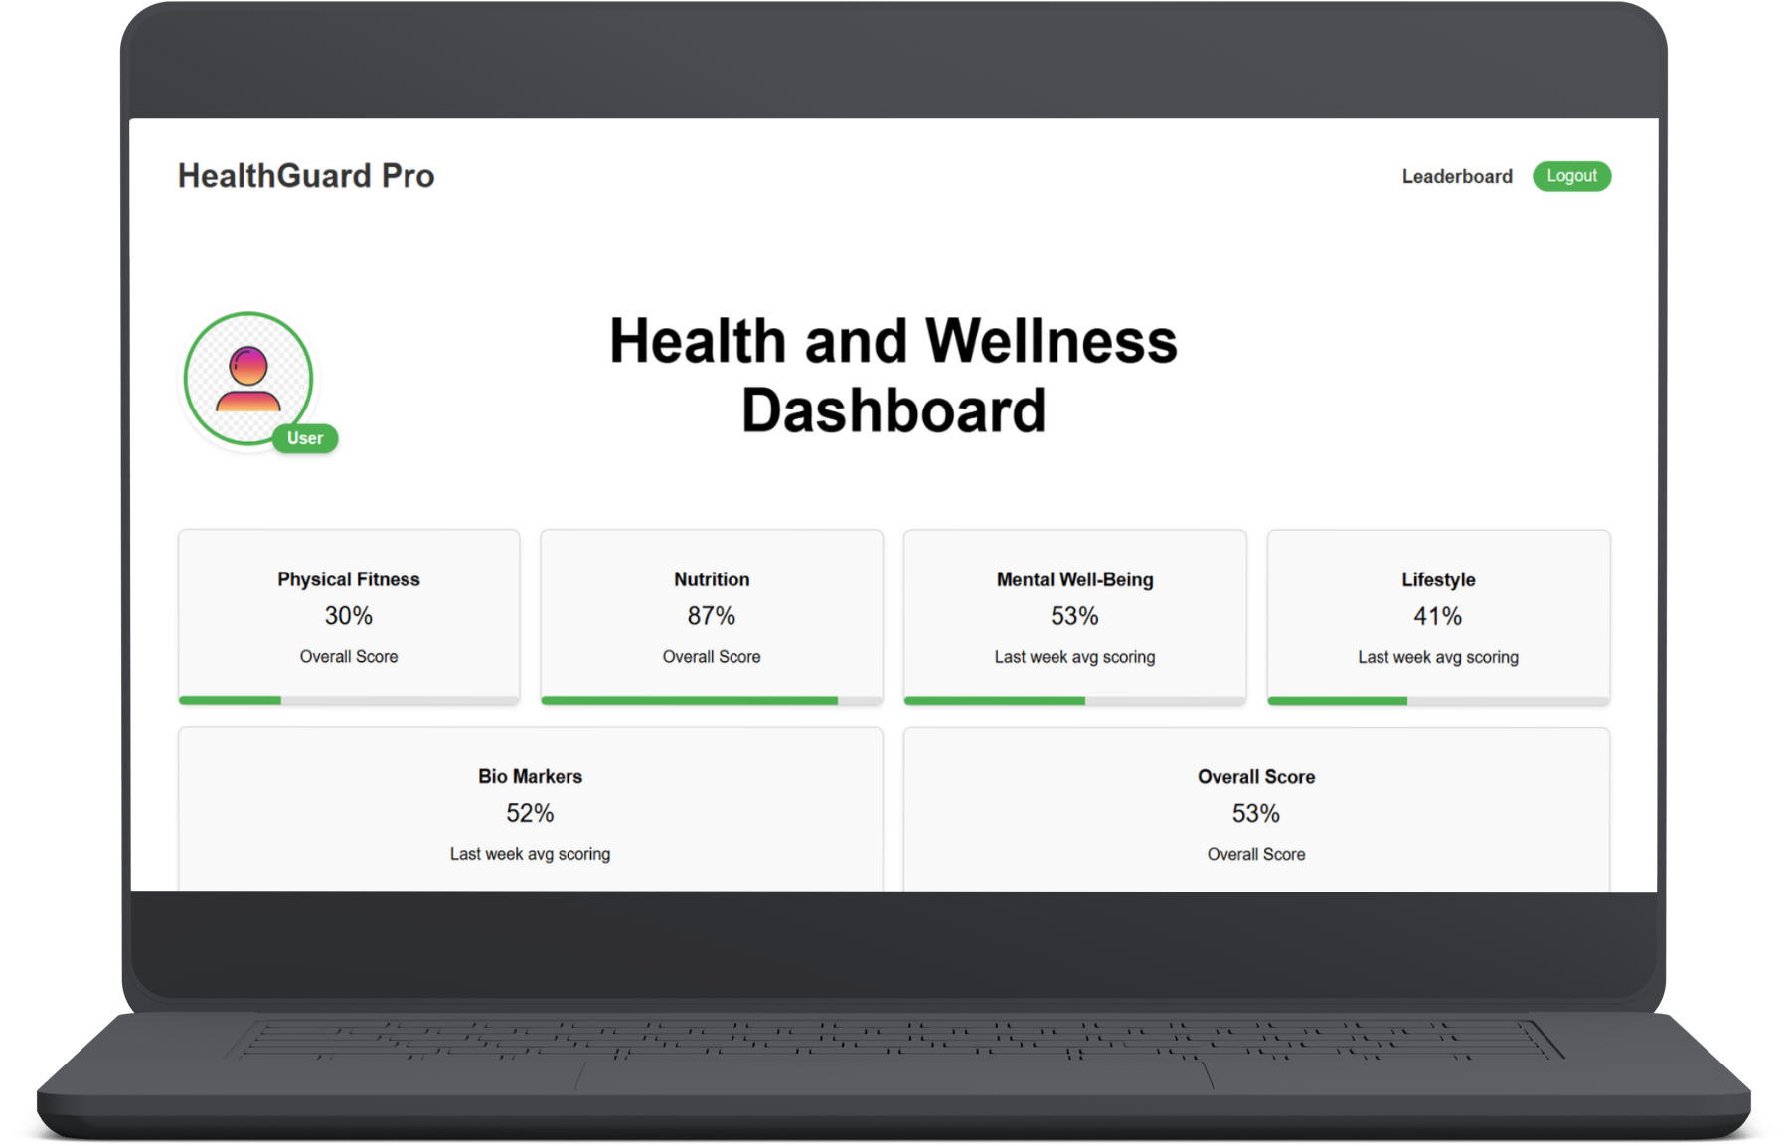
Features
Dynamic and interactive cards for each quiz category.
Real-time score updates.
User-friendly and visually engaging interface.

Slide 15
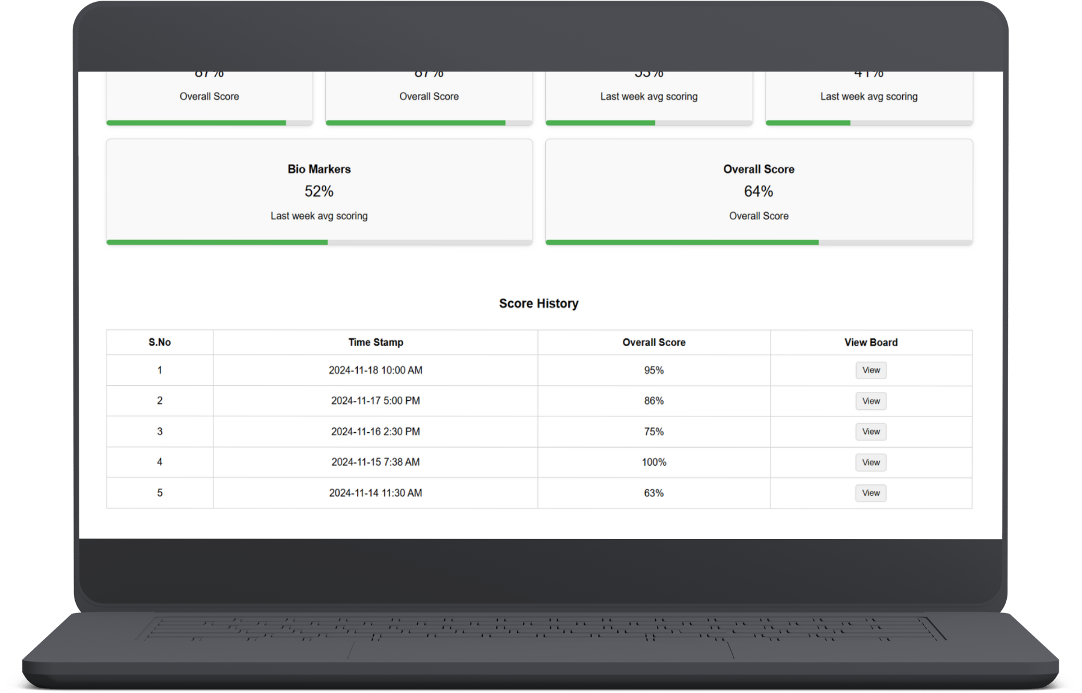

Features
View Button
Button Change to Close
Revert to Current Score

Slide 16

Let’s Explore
Dashboard

Slide 18
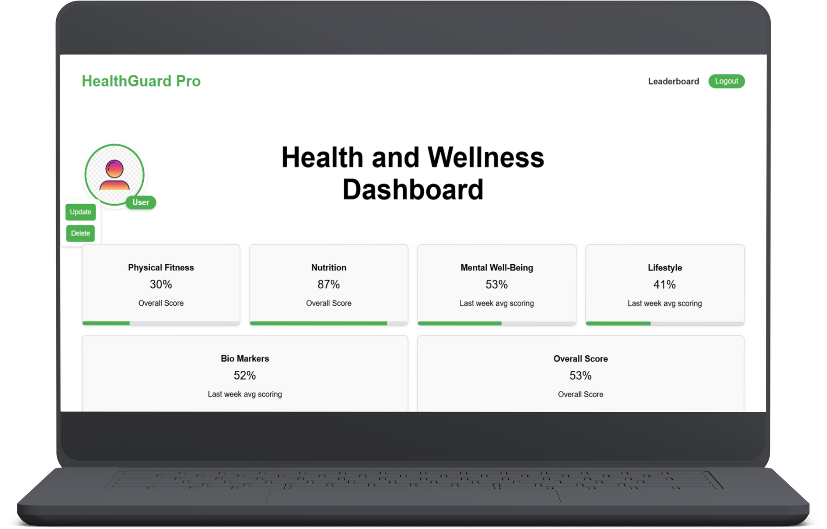

Slide 19
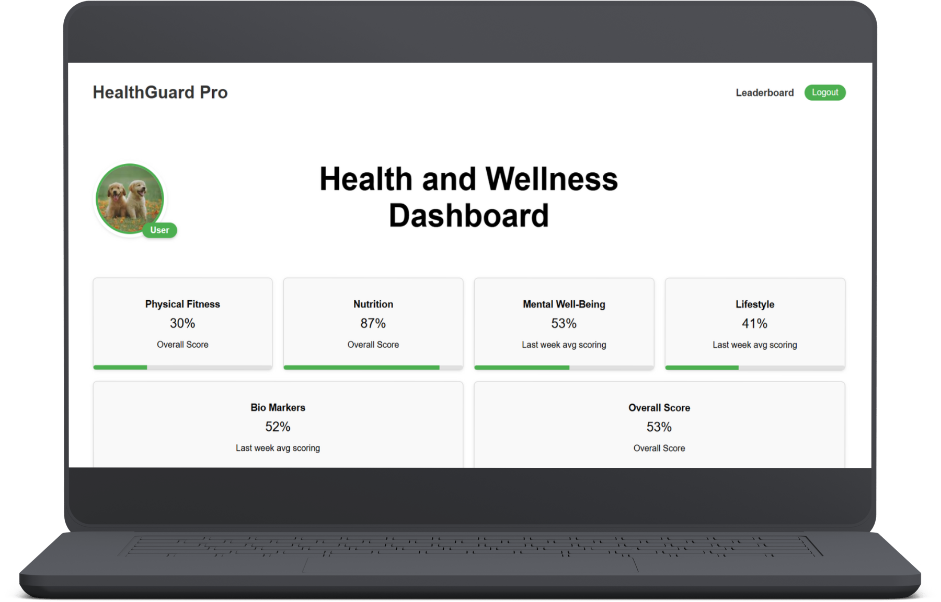

Slide 21
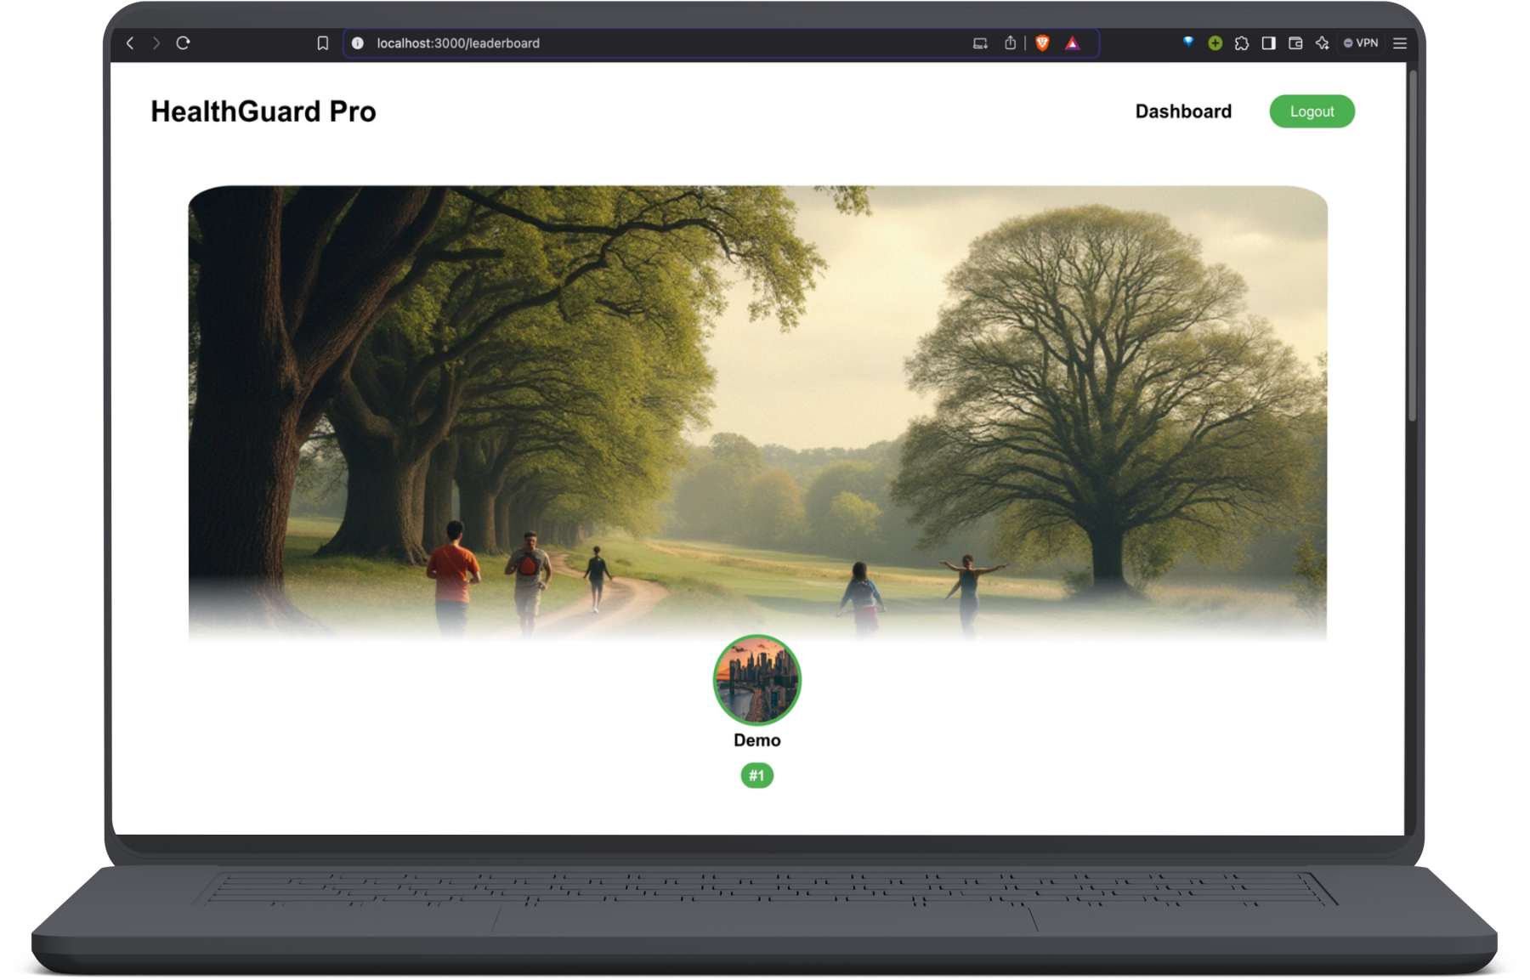

Slide 22
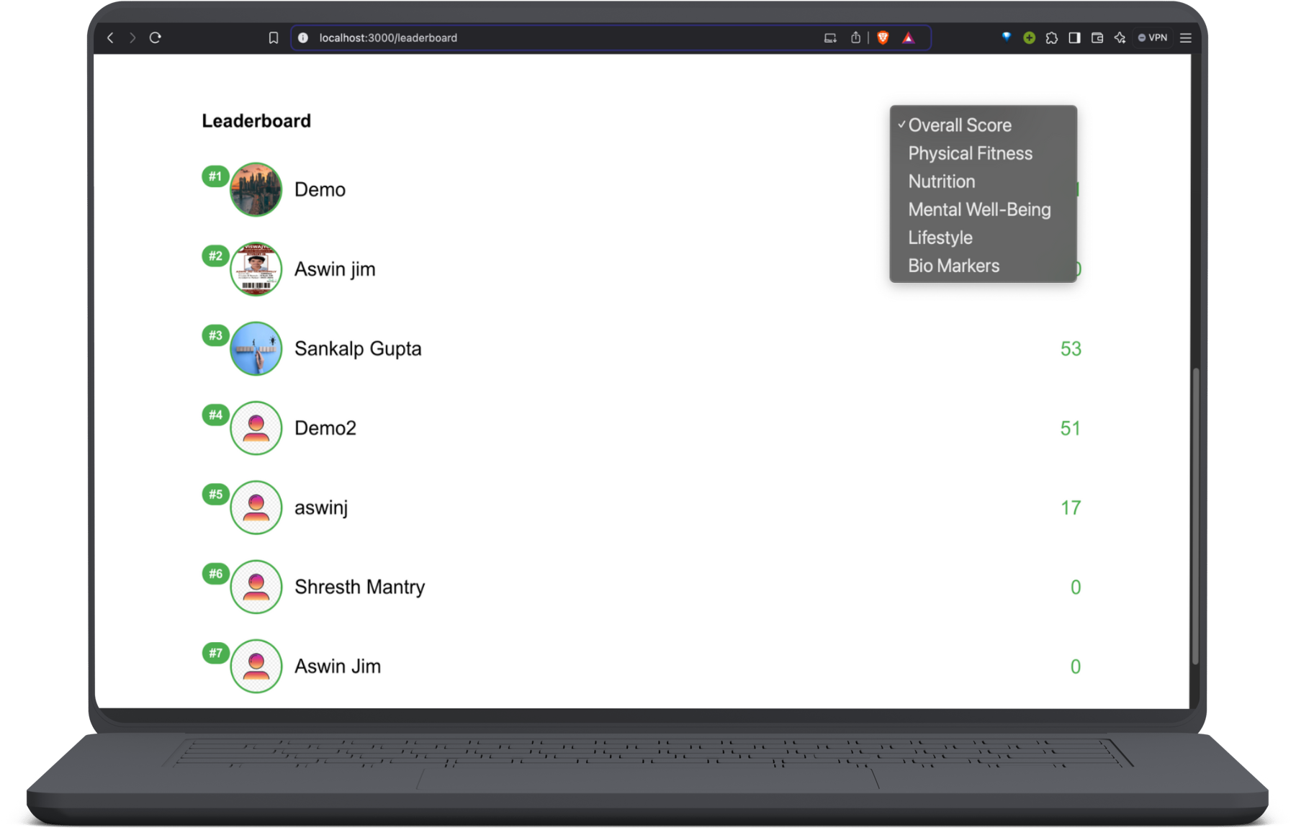

Slide 24
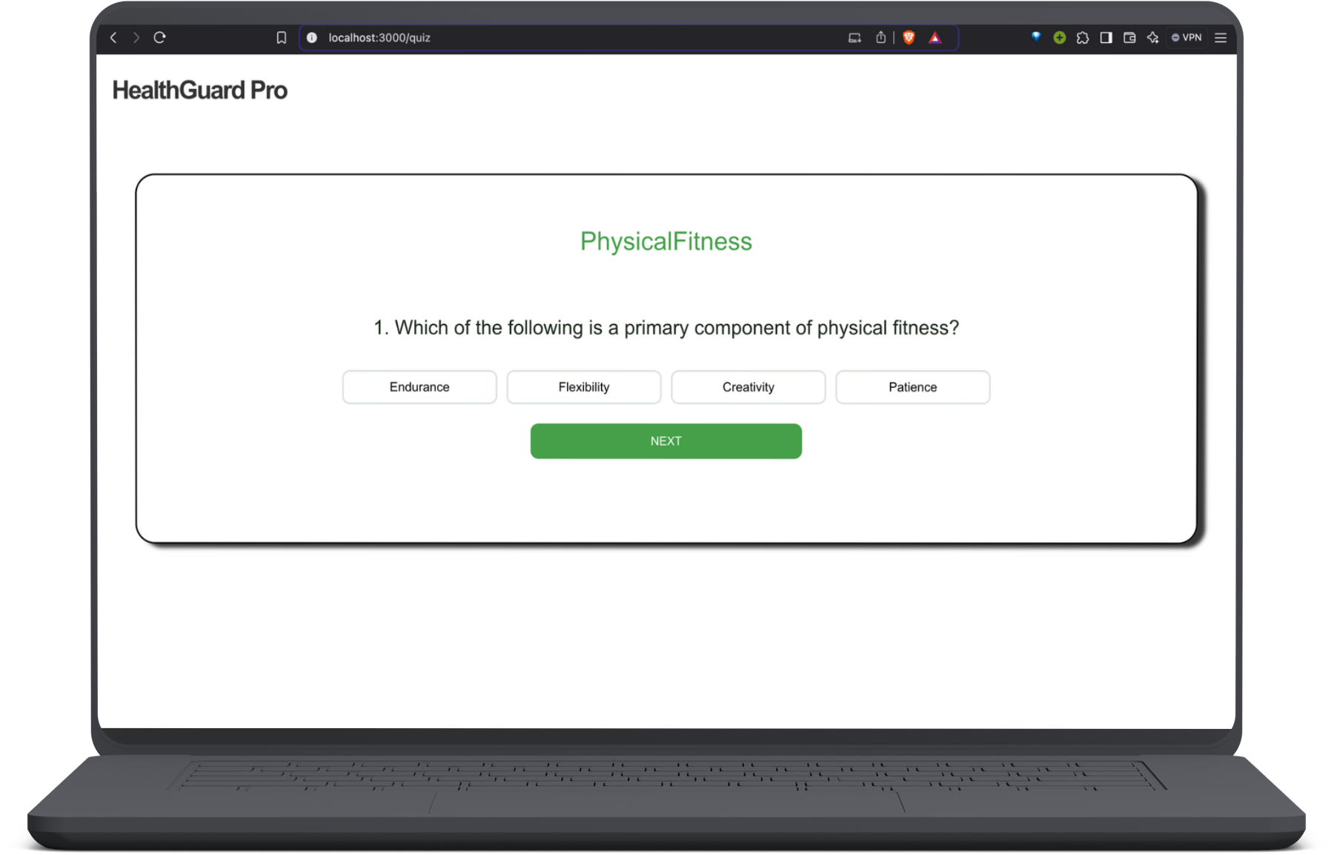

Slide 25
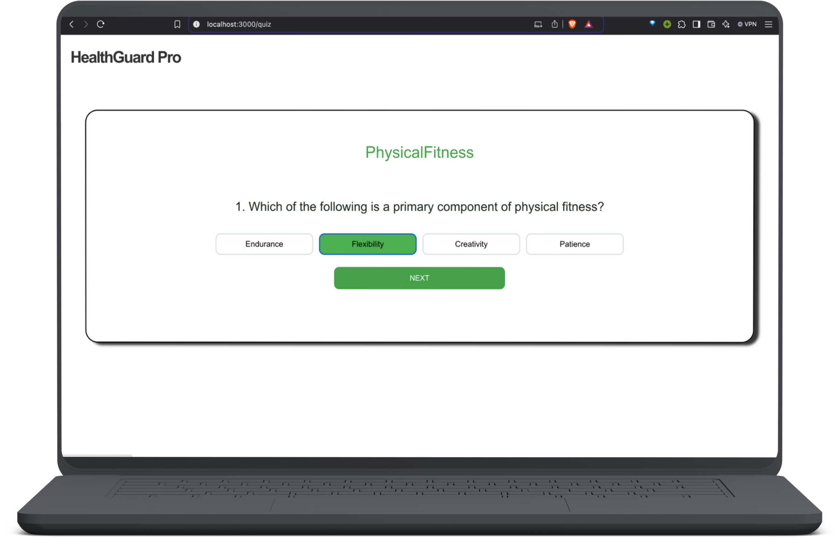

Slide 26
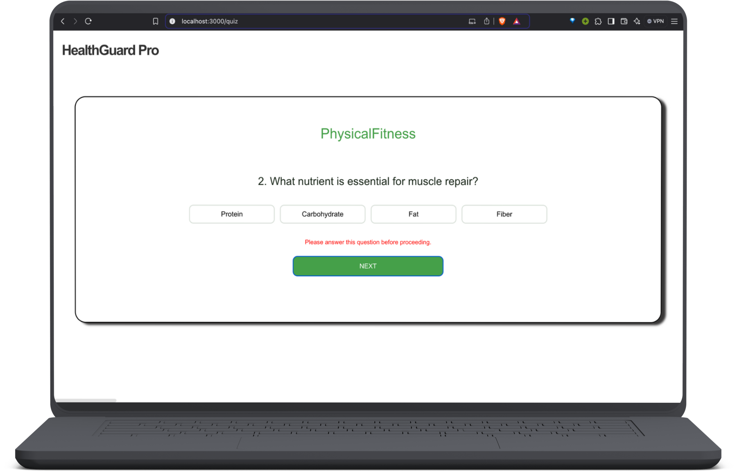

Slide 27
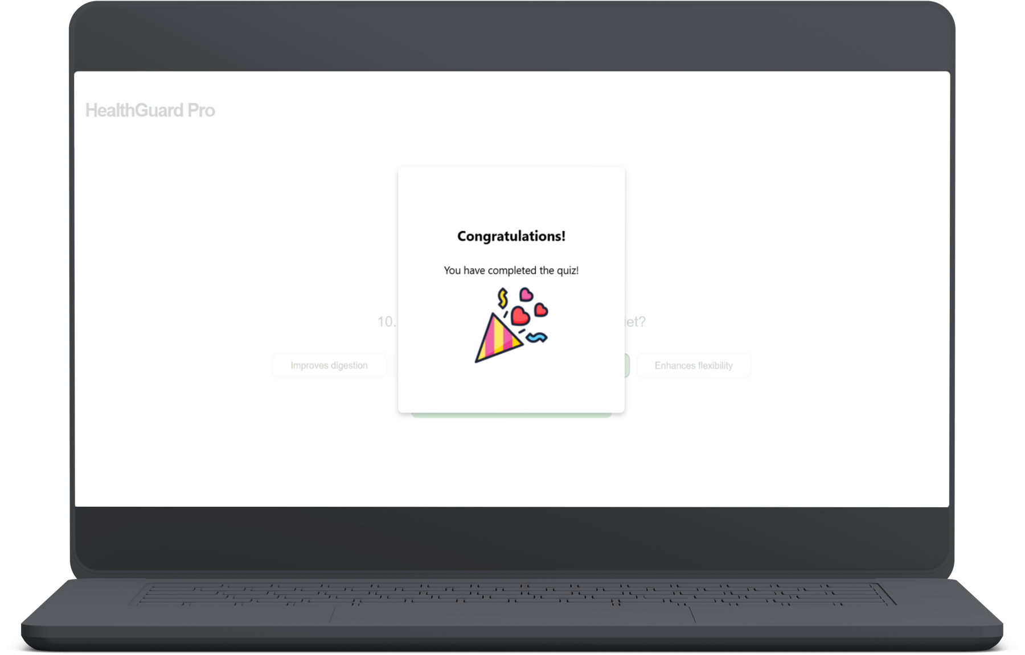

Slide 28
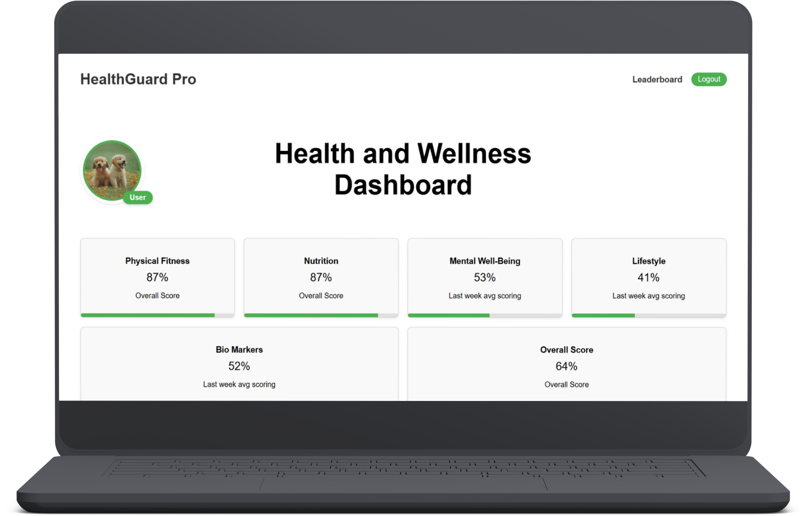


Slide 30
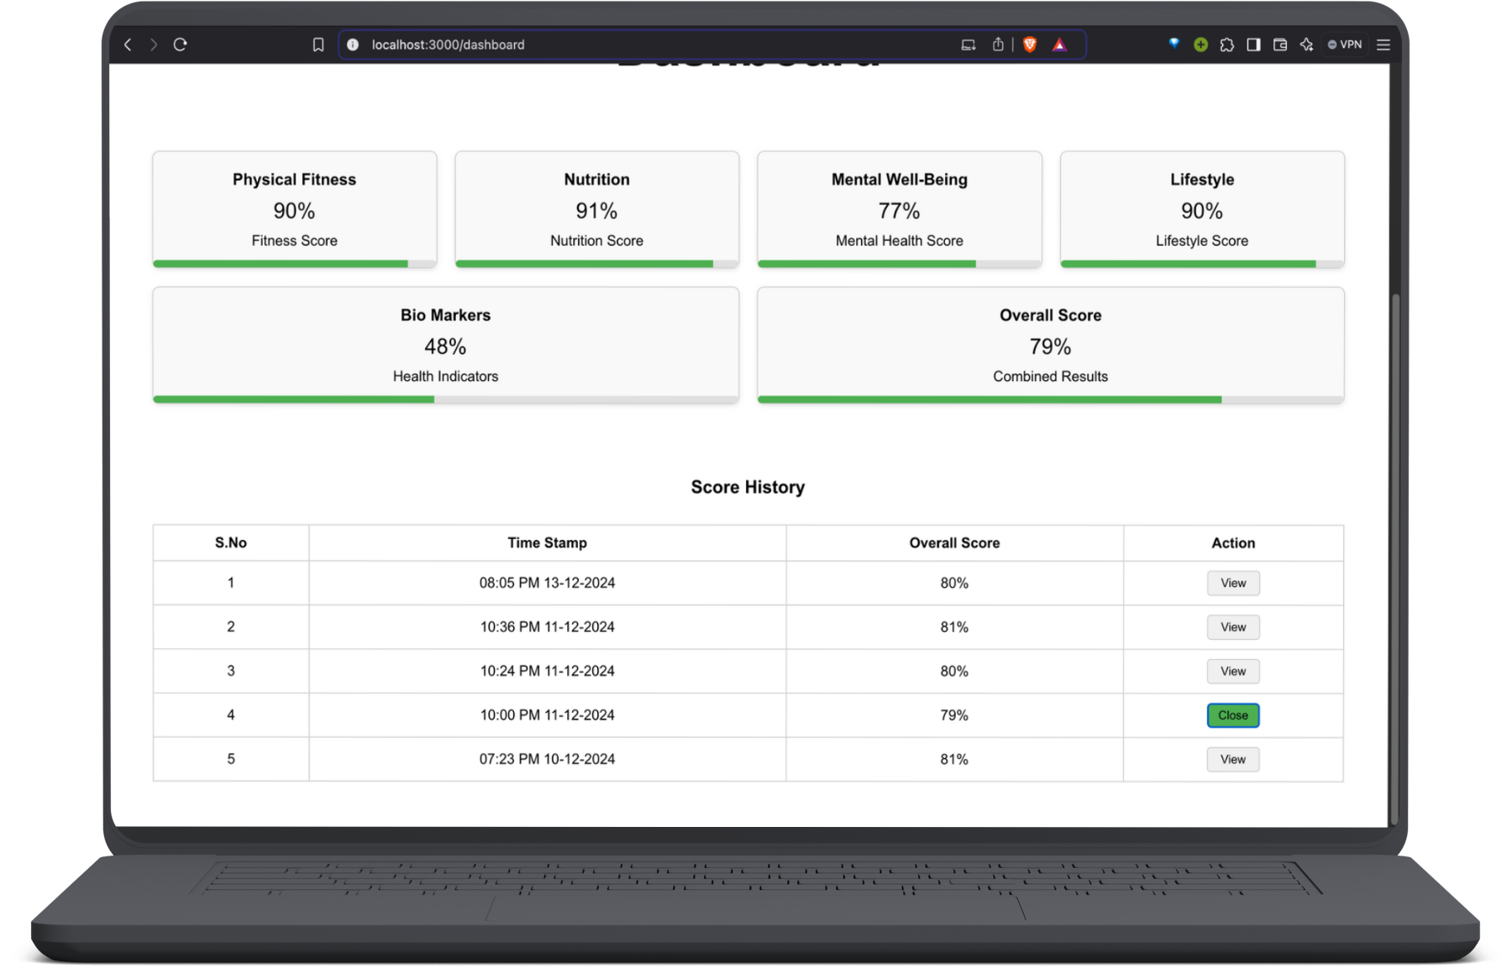

Slide 33
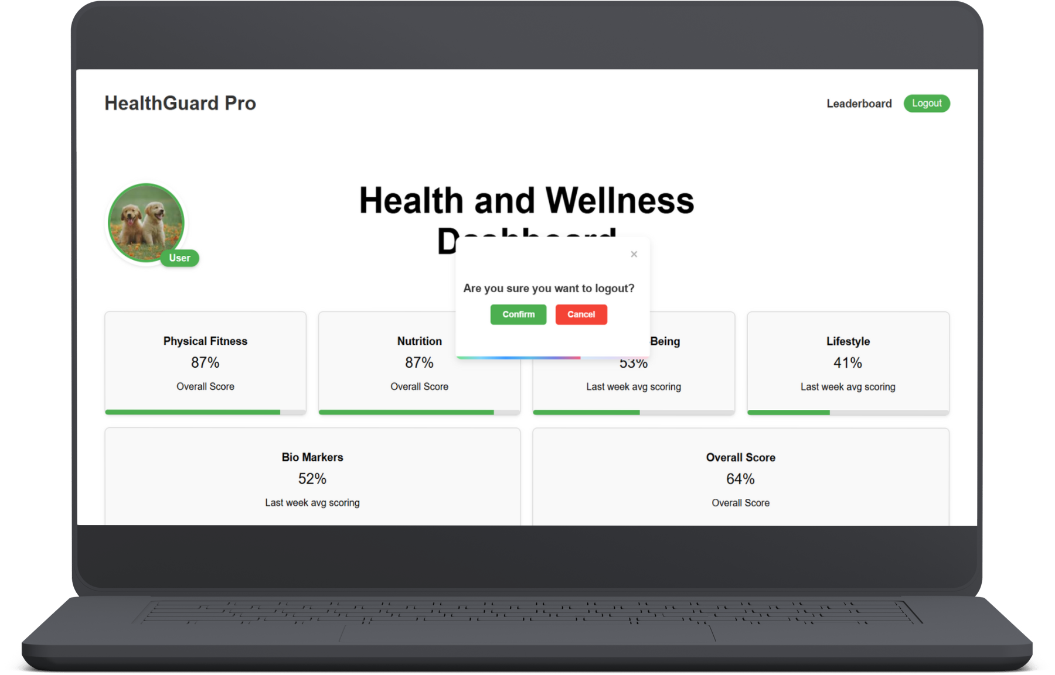

Slide 35
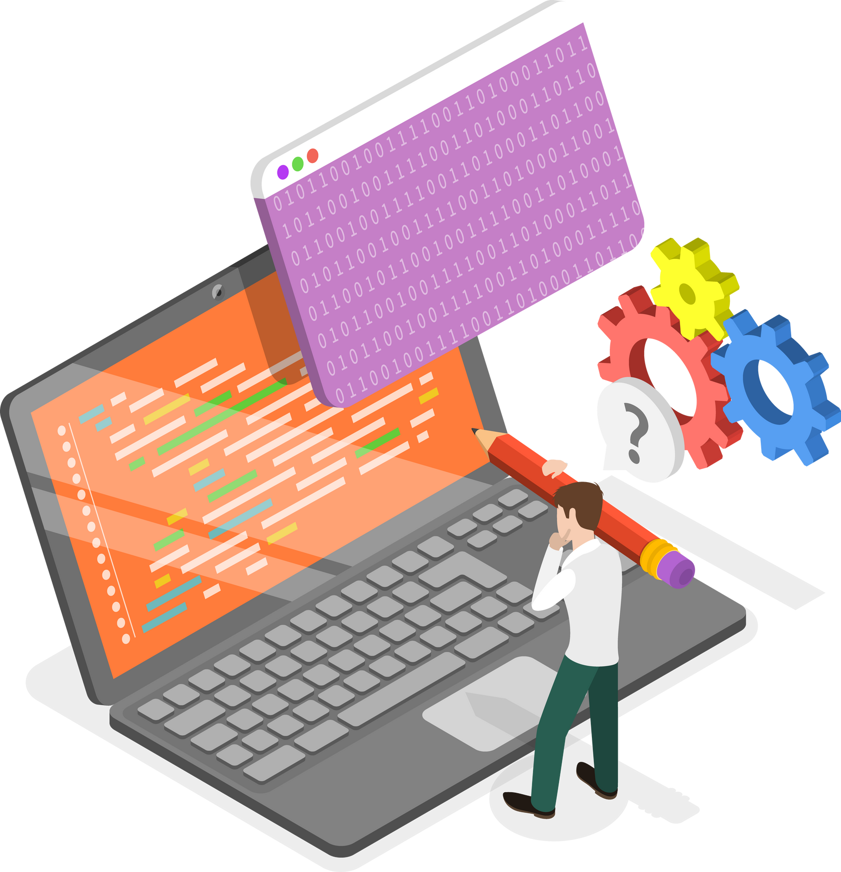
Backend

Slide 38

Database

Slide 39
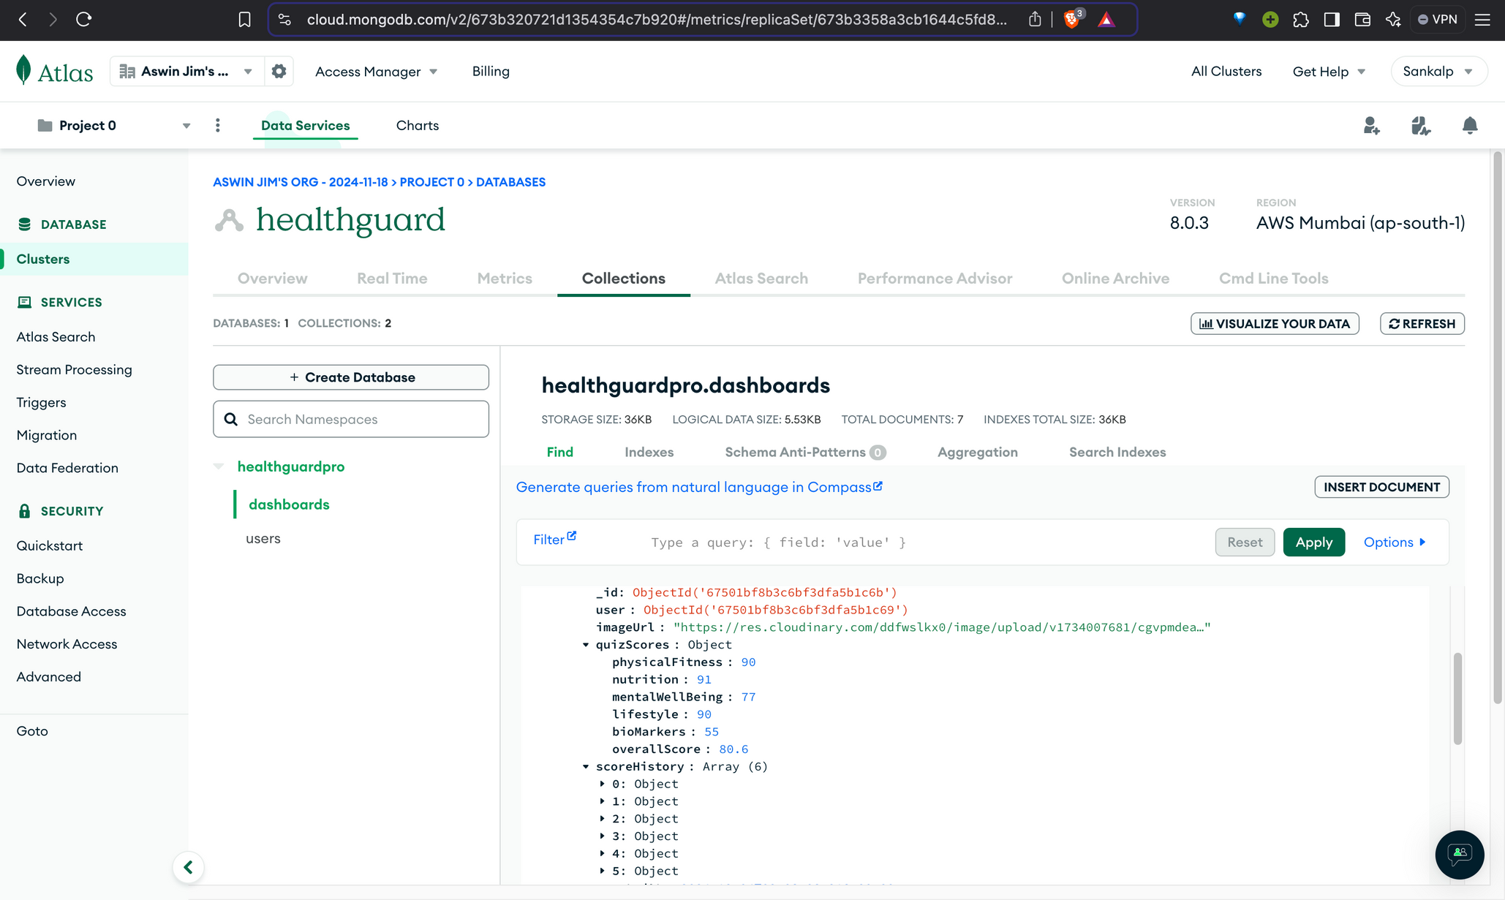

Slide 40
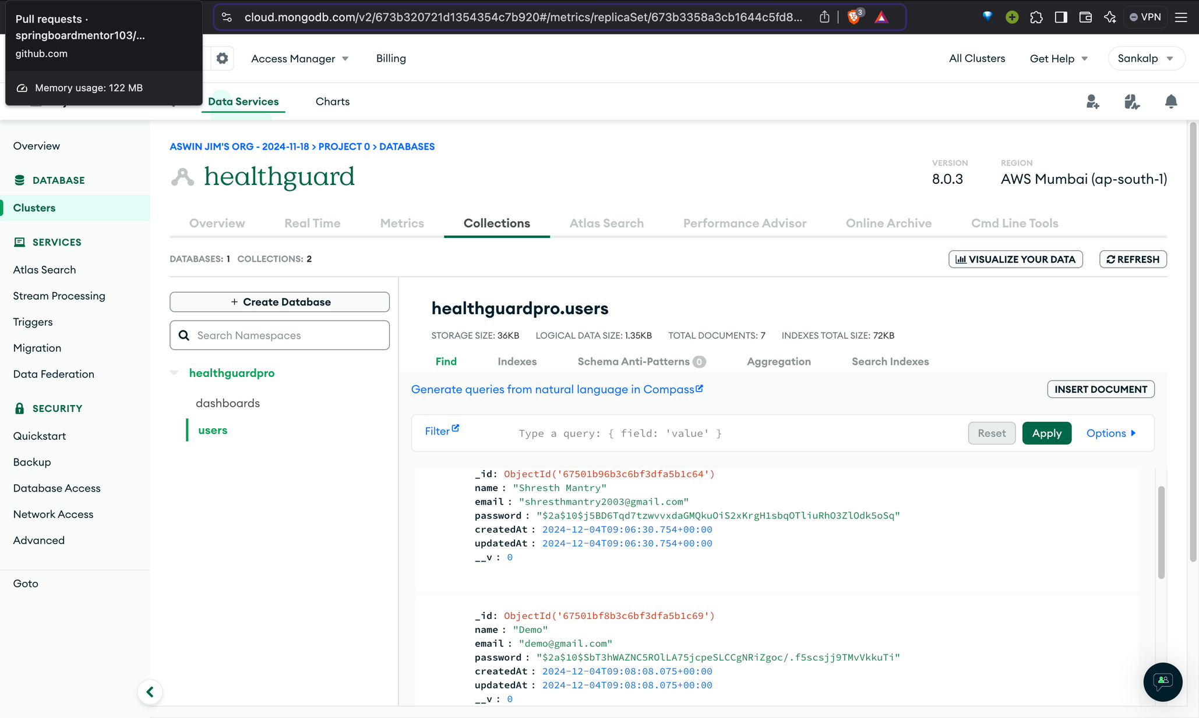

Slide 41

Why You’ll Love Using
Our Website!
🌟 Personalized Experience
💡 Practical Wellness Insights
📈 Real-Time Progress Tracking
🏆 Stay Motivated with Rewards
🤝 Challenge Your Friends!

Slide 42



Conclusion
“Health is not just a goal; it’s a lifestyle.”
Our project is designed to revolutionize the way individuals engage with their health and wellness journey. By providing personalized quizzes, real-time progress tracking, and interactive rewards, we empower users to take charge of their health in an engaging and motivating way. With a sleek and user-friendly dashboard, users can easily track their progress, connect with others, and stay motivated to reach their goals. Whether it’s improving nutrition, fitness, or overall well-being, our platform offers a fun, flexible, and insightful path to a healthier lifestyle. Join us today and start your journey toward a better, healthier you!

Slide 43

Thank you very much!

